Slide 1
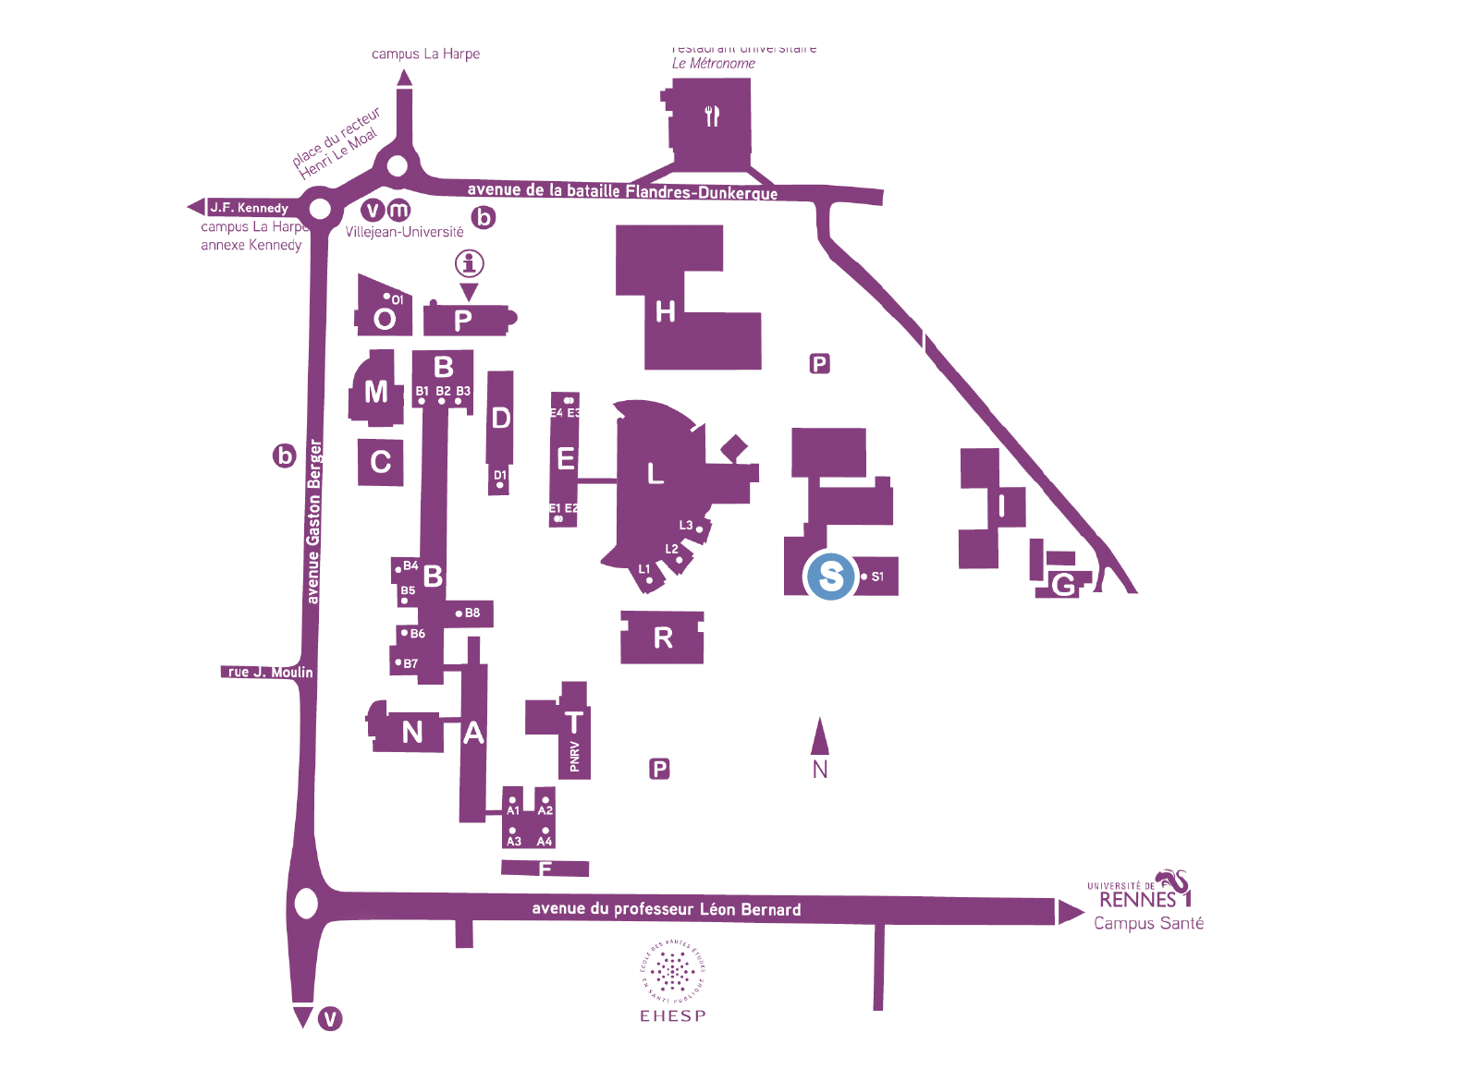
Station Métro
Parking
Colloque Management du sport

